Slide 1
Survey to analyze the impact of online learning on the physical and mental health of first year undergraduates (2020/21) at the Faculty of Science at University of Colombo.
Group – 04
Final Presentation

Slide 2

Objective
To examine how the lifestyle of every student has changed with online learning.

Slide 3
PARTICIAPANTS AND DESIGN
This study was conducted online for 2 weeks using google forms.
Participants - First year students(2020/21intake) Faculty of Science, University of Colombo.
We sent the google forms through university email to all first-year undergraduates, to get as much response as possible and we did the stratified sampling for our sample data from the responses.
Statistical analyses were performed using Minitab and Microsoft Excel.

Slide 4
ANALYSIS
Feedback to every questions were analyzed individually to gain a basic understanding of participants’ physical and mental health with the online learning – Univariate Analysis.
We also compared responses to different questions about physical and mental health to check whether they are related to each other – Bivariate Analysis.

Slide 5
Gender
There were 150 participants in the study. 56 – male 94 - female

Slide 6
Subject stream
The sample population was proportionally selected to represent the 1st year undergraduates at the faculty.
Physical science 79
ISMF 35
Bio science 29
MB 07

Slide 7
Univariate Analysis
More participants responded negatively to both engagement in physical activities
(No – 59%) and regular consumption of meals (No – 56.67%).
Sleeping hours of the majority seems to be normal (lies around 5 to 8 hours).
Majority of the participants feel that they get only a medium amount of free time(40.67%) and most of the participants feel neutral (47.33%) about their learning environment.
Most of the participants responded that their social interactions (45.33%), organization in studies (68%) and their motivation for academics (58.7%) are in a moderate level.
Only a few students are not all stressed while the rest are highly and moderately stressed.
5 to 7 hours (40.67%) seems to be the most preferred time spent for online education.

Slide 8
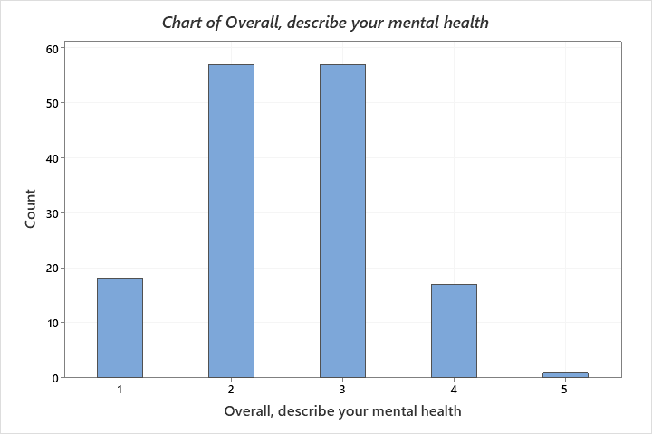
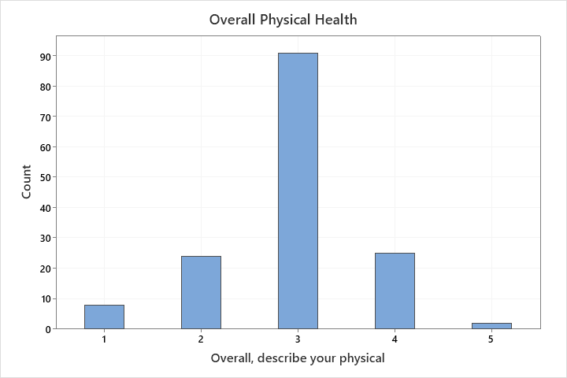
Majority prefers to use the method of attending lectures (93.33%) for learning while other methods such as watching recordings, referring to Youtube videos are also used by some of the participants.
Academic performance of majority of the respondents seems to be normal(60%).
Most of the participants feel that their physical health is normal while in the case of mental health, most feel that they are either bad or normal.
As we can observe from the below graph, most of the participants are affected mentally than physically.

Slide 9
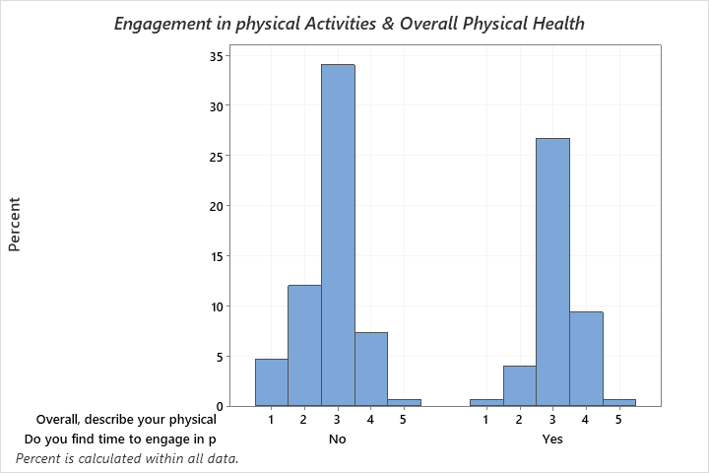
1. Engagement in physical activities & Overall physical health
Bivariate Analysis
Students who find time to engage in physical activities seem to have a comparatively better health than the students who do not engage in them.

Slide 10
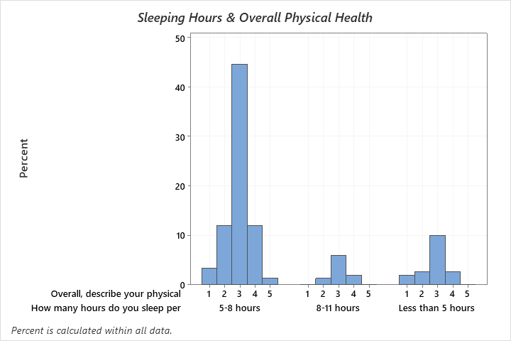
2. Sleeping hours & Overall physical health
Majority sleeps around 5-8 hours and they have a good physical health compared to others who sleep 8-11 hours and less than 5 hours.

Slide 11
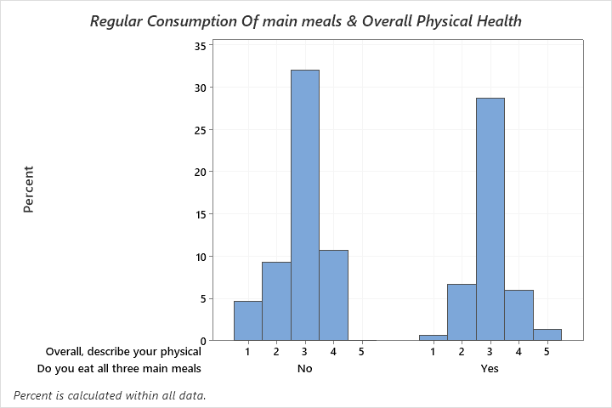
3. Regular consumption of main meals & Overall physical health
Students who have their main meals without skipping seem to have a better health compared to those who skip the meals.

Slide 12
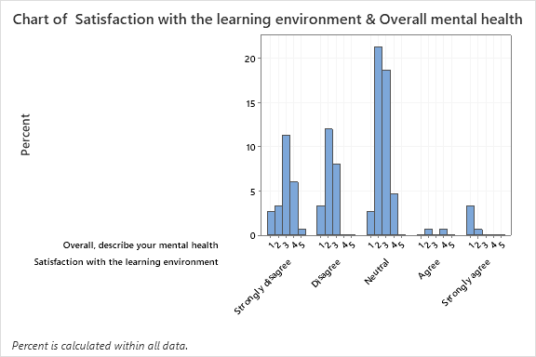
4. Satisfaction with the learning environment & Overall mental health
Since those who are very satisfied with the learning environment seems to have a bad mental health and those who are not satisfied seems to have better health than them, so this graph doesn’t seem to produce the expected result.

Slide 13
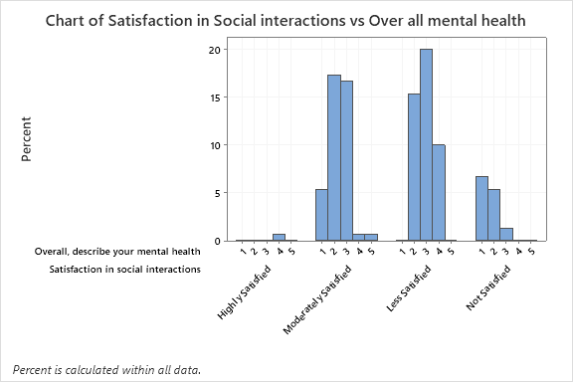
5. Satisfactory level of social interactions & Overall mental health
Students who have a good social interaction seems to have better mental health according to the graph.

Slide 14
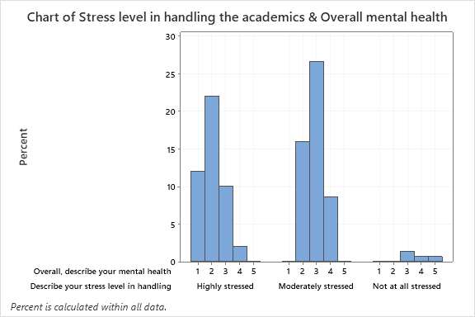
6. Stress level in handling the academics & Overall mental health
Participants who are highly stressed seems to have a lower mental health while the participants who are not at all stressed seems to have better health.

Slide 15
CONCLUSIONS
Factors such as stress level, social interactions and amount of free time seems to have made a notable impact on the mental health while the engagement in physical activity and the food habits have made the impact on physical health.
Factors such as organization in studies, academic performance and motivation for academics doesn’t seem to have a huge impact on the mental health.
Respondents feel in a way that they are affected more mentally than physically.
From the open-ended question, we analyzed and concluded that nearly all of the respondents want to have physical education instead of online learning.

Slide 16
LIMITATIONS
Result that we expect doesn’t reflect in the analysis.
E.g. : Bivariate analysis of Satisfaction with learning environment and overall mental health.
Since most of the answers to the questions are categorical, some respondents might have exaggerated in their response.
Since we conducted our survey through online, some participants who don’t understand the question correctly might have responded incorrectly.
60%

Slide 17
Thank You !

